Slide 1
HTML - CSS - DOM
Understanding the basics
Notes:
Course name :JS Basics
Module : Understanding the basics

Slide 2
Goals
To understand HTML and basic tag functionalities
To know the basics of styling and uses of CSS
To understand structure of a Web Page (DOM)
A discussion over BootStrap Library
Live Demos
Notes:
which adds to capability of student to do something/understand something

Slide 3
HTML
Notes:
section : variables
Subsection : if required (black 28pt)

Slide 4
HTML : What ?
HTML is Hyper Text Markup Language
It’s a markup understood by browsers
It’s not a programming language
It creates DOM which is the web page
Notes:
Blue color is 37,77,196
Max statements 5

Slide 5
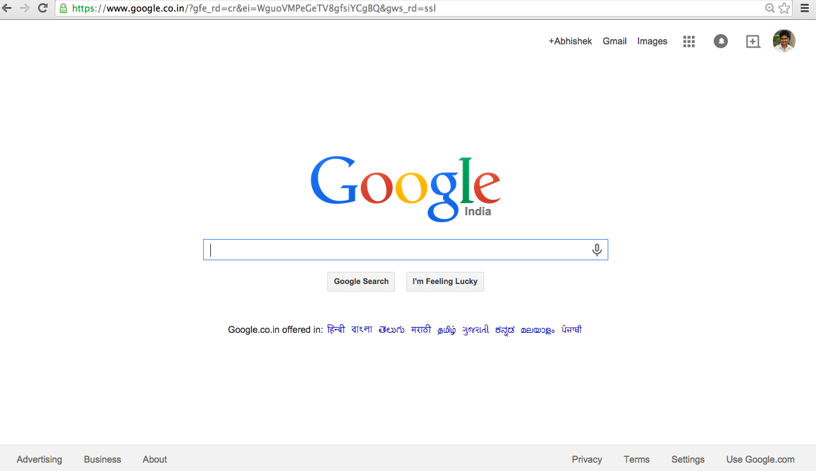
HTML Structure
HTML has two main sections :
HEAD : contains meta data used by browser
BODY : main viewable part of web page
BODY
Notes:
Blue color is 37,77,196
Max statements 5

Slide 6
Page Structure
<html>
<head> - Contains information about the page such as TITLE, STYLE tags, CSS and preload JS Components.
<title> This will be visible in the title bar of the viewers’ browser. </title>
</head> - Closes the HTML <head> tag. <body> - This is where you put visible page components. Also you can put asynchronous JS Components here.
</body> </html>
Notes:
Blue color is 37,77,196
Max statements 5

Slide 7
Semantic Structure(HTML5)
<body>
<header>
...
</header>
<nav>
<ul>...</ul>
</nav>
<footer>
...
</footer>
</body>
Notes:
Blue color is 37,77,196
Max statements 5

Slide 8
Most Used HTML Tags
Covers more than 90% of HTML use
TAGS | Purpose
<h1>,<h2>…<h6> | Any Heading/Title
<p> | Any text
<br> | For Line breaks
<img> | Images
<a> | Links
<ul> and <li> | List and Items
<strong> | Bold
<em> | italics
<div> and <span> | containers for styling/positioning
Notes:
Blue color is 37,77,196
Max statements 5

Slide 9
HTML Attributes
Attributes are specific to the tag it is associated with
Commonly used Attributes are given here
Attributes | Used with Tags | Purpose
href | <a> | to set Link target
src | <img> | to set image source
id | <div>,<p> .. | to give unique element Id
class | <div>,<p> .. | to link styles
style | <div>,<p> .. | to add style properties
alt | <img> | alternate text
Notes:
Blue color is 37,77,196
Max statements 5

Slide 10
SEO Tags
<html>
<head>
<title> This will be visible in the title bar of the viewers’ browser. </title>
<meta name="description" content="Awesome Description Here">
</head> - Closes the HTML <head> tag. <body>
<H1> This is my website </H1>
</body> </html>
Notes:
Blue color is 37,77,196
Max statements 5

Slide 11
DOM
Notes:
section : variables
Subsection : if required (black 28pt)

Slide 12
DOM
DOM is Document Object Model
DOM is created by browser on reading HTML
DOM is the real page view which we see
DOM can be manipulated after initial read (JavaScript)
DOM is a tree data structure
Notes:
Blue color is 37,77,196
Max statements 5

Slide 13
DOM Tree
HTML
DIV
DIV
P
IMG
BODY
HEAD
Text
Notes:
Blue color is 37,77,196
Max statements 5

Slide 14
Web Page Elements
A DOM tree is constructed from HTML Elements.
Each HTML Element has 3 parts :
Tag : to specify the category of element
Attributes : to set property of the element
Data : to add some data ( optional )
<div id=“container”>Text</div>
Notes:
Blue color is 37,77,196
Max statements 5

Slide 15
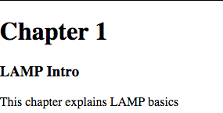
Web Page & DOM
<html>
<head>
<title> Web Example</title>
</head>
<body>
<h1> Chapter 1</h1>
<h3> LAMP Intro</h3>
<p>This chapter explains LAMP basics </p>
</body>
</html>
Browser View
index.html
Notes:
consolas font for code

Slide 16
DOM Tree
HTML
h1
P
h3
BODY
“chapter 1”
“LAMP intro”
“This chapter explains LAMP basics “
HEAD
title
“LAMP example”
Notes:
Blue color is 37,77,196
Max statements 5

Slide 17
CSS
Notes:
section : variables
Subsection : if required (black 28pt)

Slide 18

HTML <DIV>
<div> is most important tag for HTML styling as it :
acts as a container for grouping elements.
can be used for position containing elements.
can be used for margining and bordering
Header Text
Paragraph text containing some information
DIV
Notes:
browser has it own cascading style sheets

Slide 19
DIV properties
DIV elements have few common properties
by default they start from next line
DIVs can be nested into other DIVs
DIVs is generally identified with ID or CLASS attribute
<div id=“div1”> </div>
<div class=“blue”> </div>
<div id=“div2”> </div>
<div class=“blue”> </div>
div1
class=blue
div2
class=blue
Notes:
browser has it own cascading style sheets

Slide 20
ID vs Class
ID and Class are mostly used to select a particular element
ID is unique and single
ID can be given to only one element per HTML
One HTML element can have only one ID
CLASS is reusable and many can be used together
Class can be given to any number of elements
Multiple class can be used in Single HTML Element
<div class=“blue bold”> </div>
<div id=“div2”> </div>
<div class=“blue”> </div>
class=blue bold
div2
class=blue
Notes:
browser has it own cascading style sheets

Slide 21
Style : What is it ?
Style is a collection of visual properties of HTML element
e.g. StyleBold = { Font is bold, background color is blue}
.Style-Bold { font-weight: bold; background:blue;}
style.css
<div class=“Style-Bold”>Style Bold </div>
Style Bold
Notes:
browser has it own cascading style sheets

Slide 22
CSS : What ?
CSS is Cascading Style Sheets
It is a collection of styles or CSS Elements
It separates all styling/positioning tasks from HTML.
It helps in reusing styles over multiple pages.
It helps in reducing the size of HTML files.
.Style-Bold { font-weight: bold; background:blue;}
.Style-Orange { background : orange;}
CSS Element
CSS file
Notes:
browser has it own cascading style sheets

Slide 23
CSS Elements
CSS Element is a single style object
Selector { property : value ; }
Used for naming style
Visual property
Visual property value
.style-one {color:red;}}
Notes:
browser has it own cascading style sheets

Slide 24
CSS Selector
There are 3 kinds of selectors :
Applied using in-built HTML tag name ( p,div )
Applied using CLASS ( .style-bold,.style-orange )
Applied using ID ( #style-bold )
p {color:red;}
}p
.style-1{font-weight:bold;}
}
#login{background:blue;}}p
<p> text is red </p>
<p class=“style-1”> text is bold</p>
<div id=“login”>username</div>
}p
}
CSS file
HTML file
Notes:
browser has it own cascading style sheets

Slide 25
CSS Inclusion
CSS can be declared in few different ways
In separate .css file included in HTML using <link> Tag
In same HTML Head <style> Tag
<link href=“style.css” type=“text/css rel=“stylesheet”>
<style>
.style1{ color:red;}
</style>
Notes:
Blue color is 37,77,196
Max statements 5

Slide 26
Attaching a style
CSS included by external file or internal <style> tag is used from class attributes
<style>
.style1{ color:red;}
</style>
<div class=“style1”></div>
We can also attach style using style attribute, this is called inline-css
<div style=“color:red;”></div>
Notes:
Blue color is 37,77,196
Max statements 5

Slide 27
CSS properties
Common CSS properties and their purpose
CSS properties | Purpose
color | change font color
font | change font properties
border | change border properties
background | change element background
margin | Links
padding | List and Items
width | width of elements
height | height of elements
Notes:
Blue color is 37,77,196
Max statements 5

Slide 28
CSS Box Model
CSS box model is followed by most HTML elements
MARGIN
BORDER
PADDING
CONTENT
Notes:
Blue color is 37,77,196
Max statements 5

Slide 29
CSS Box Model
CSS box model is followed by most HTML elements
Padding
Border
THIS IS CONTENT.
Margin
THIS IS ANOTHER PARAGRAPH
Notes:
Blue color is 37,77,196
Max statements 5

Slide 30
CSS Shorthand properties
CSS have a shorthand form for related properties
background-color: #000;
background-image: url(images/bg.gif);
background-repeat: no-repeat;
background-position: top right;
background: #000 url(images/bg.gif) no-repeat top right;
Notes:
Blue color is 37,77,196
Max statements 5
z

Slide 31
CSS Directional rule
CSS has a direction rule for making shorthand code
1.TOP
2.RIGHT
3.BOTTOM
4.LEFT
margin-top: 2px;
margin-right:4px;
margin-bottom:6px;
margin-left:8px;
margin: 2px 4px 6px 8px;
Notes:
Blue color is 37,77,196
Max statements 5

Slide 32
CSS3
CSS3 has some interesting properties which one can use
CSS3 properties | Purpose
transform | X Y Z axis transformation
transition | one page to another transition
animation | animating HTML objects
gradient | Gradient in backgrounds
Notes:
Blue color is 37,77,196
Max statements 5

Slide 33
URL and Locations
Notes:
section : variables
Subsection : if required (black 28pt)

Slide 34
URL
A Uniform Resource Locator provides location of resource
Protocol + Site Address + File location
http://www.google.com/mail/index.html

Slide 35
Absolute vs Relative URL
/images/pic.jpeg
http://www.google.com/mail/index.html

Slide 36
Contact Info
Abhishek Rathore
E-mail: contact@youstart.in
Website: youstartlabs.in
Notes:
Blue color is 37,77,196
Max statements 5

Slide 37
Thank You

